Slide 1
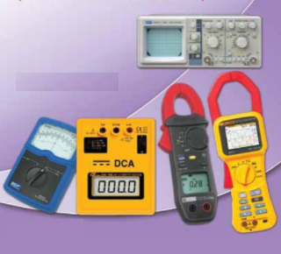
ELECTRONIC MEASUREMENTS
AND INSTRUMENTATION
Instructor: Mr. B.ManiKanth, Assistant Professor
Department of Electronics and Communication Engineering

Slide 2
Syllabus
UNIT-1
Performance characteristics of instruments, Static characteristics, Accuracy, Resolution, Precision, Expected value, Error, Sensitivity. Errors in Measurement, Dynamic Characteristics-speed of response, Fidelity, Lag and Dynamic error. DC Voltmeters- Multi-range, Range extension/Solid state and differential voltmeters, AC voltmeters- multi range, range extension, shunt. Thermocouple type RF ammeter, Ohmmeters series type, shunt type, Multi-meter for Voltage, Current and resistance measurements

Slide 3
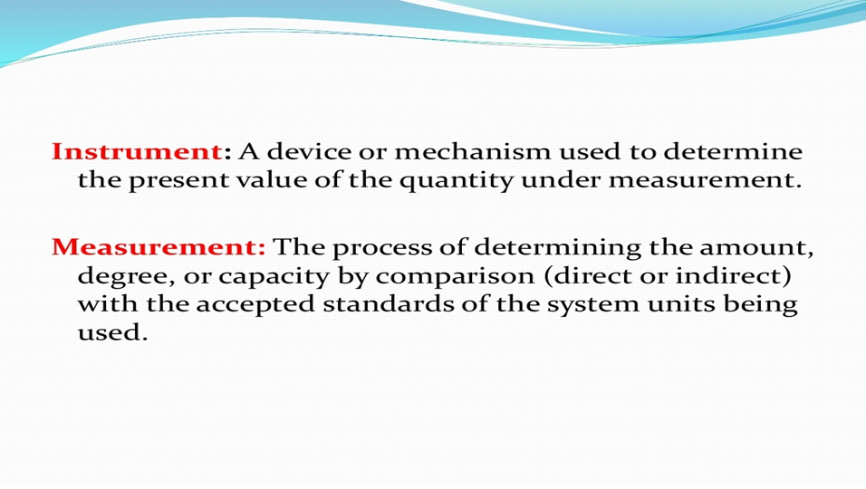

Slide 4
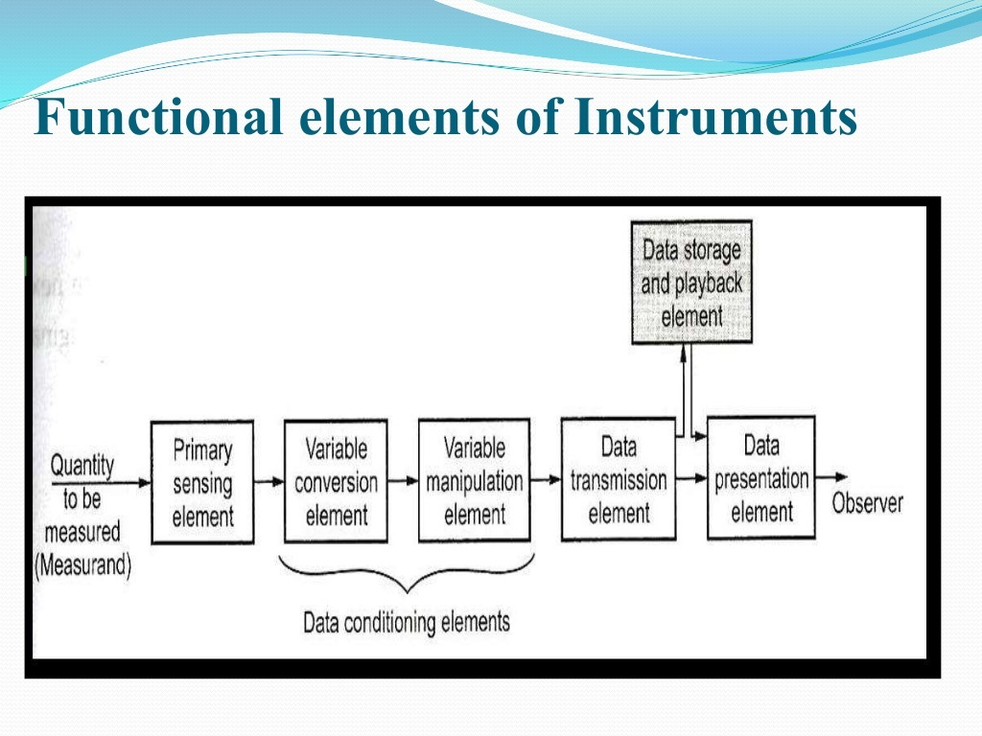

Slide 5
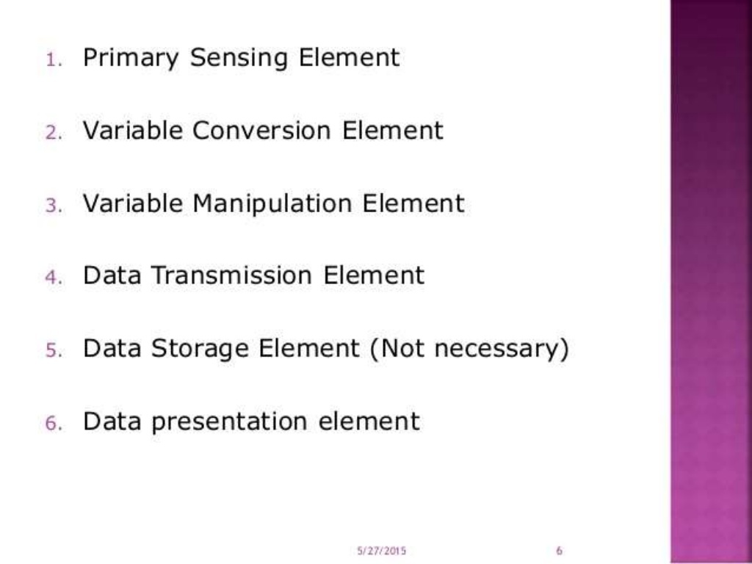

Slide 6
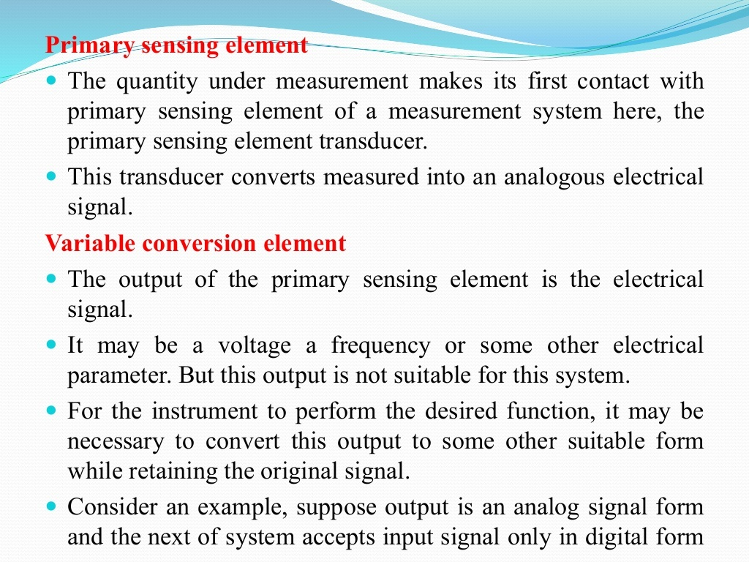

Slide 7
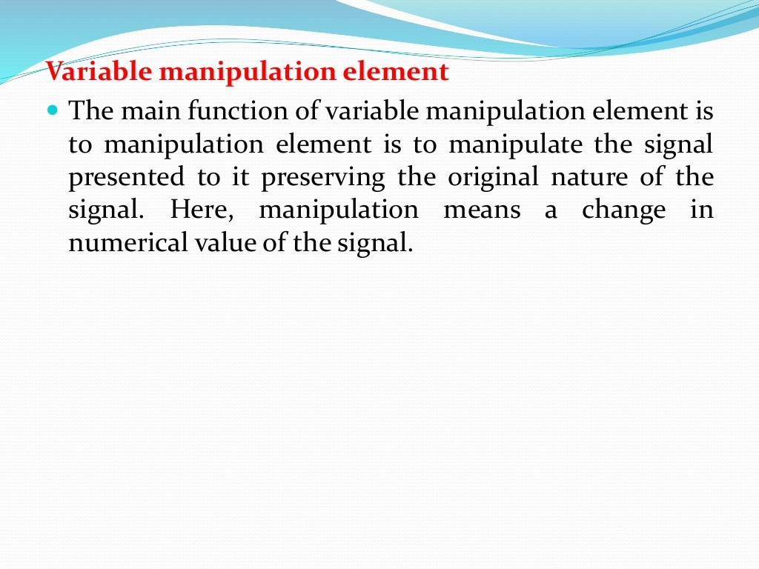

Slide 8
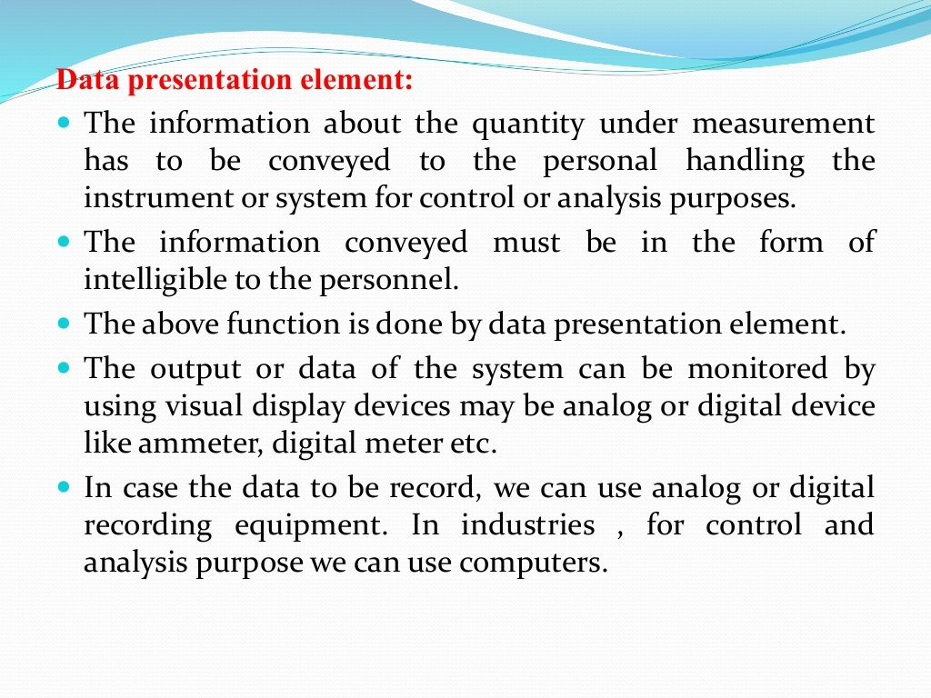

Slide 9
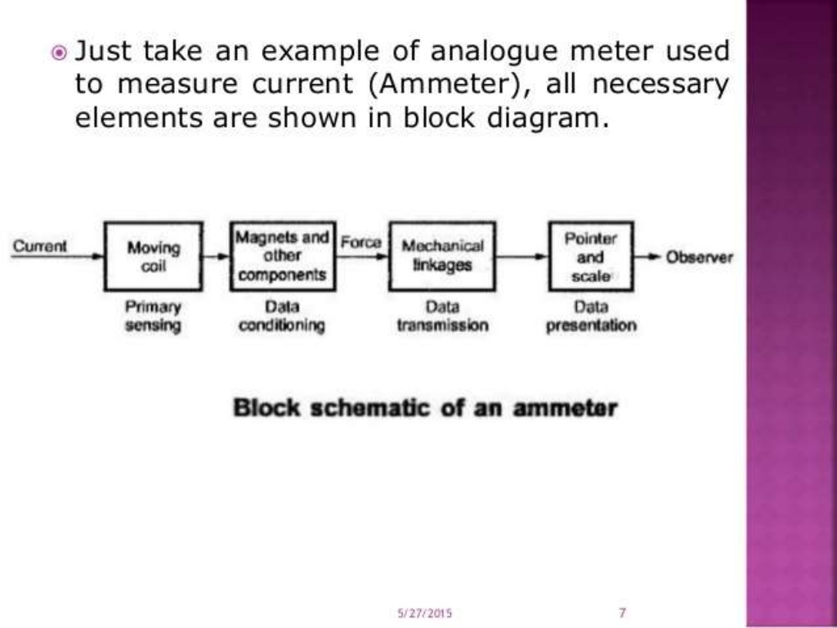

Slide 10
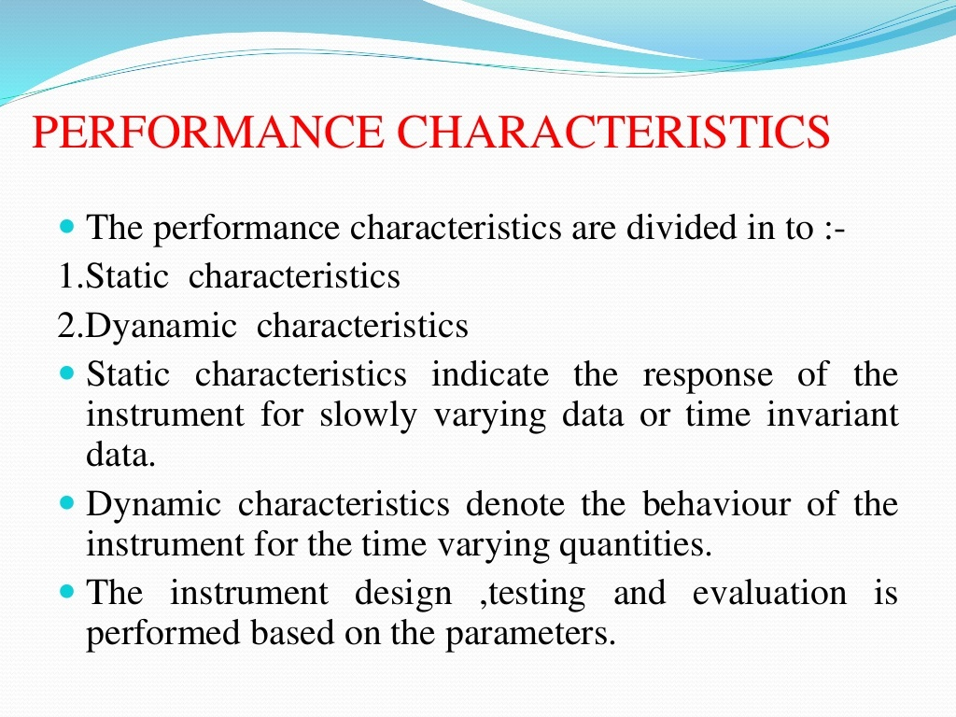

Slide 11
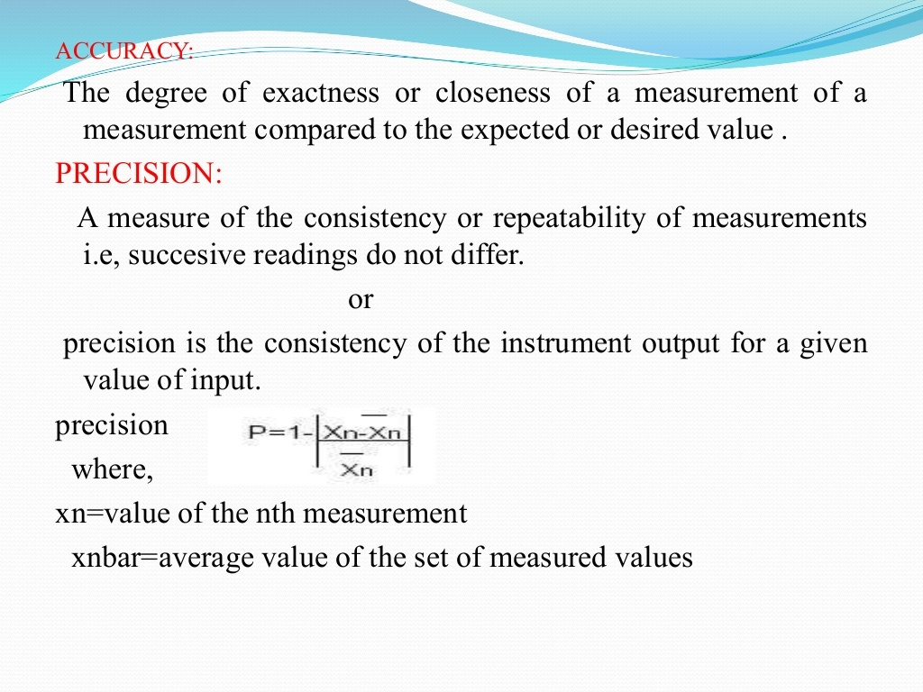

Slide 12
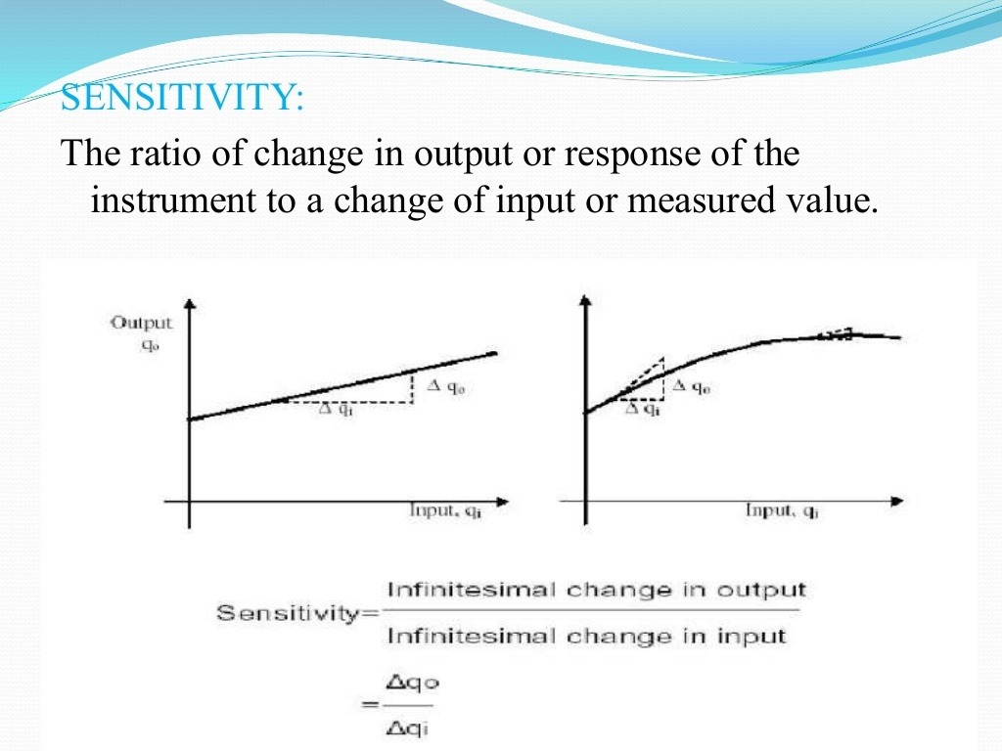

Slide 13
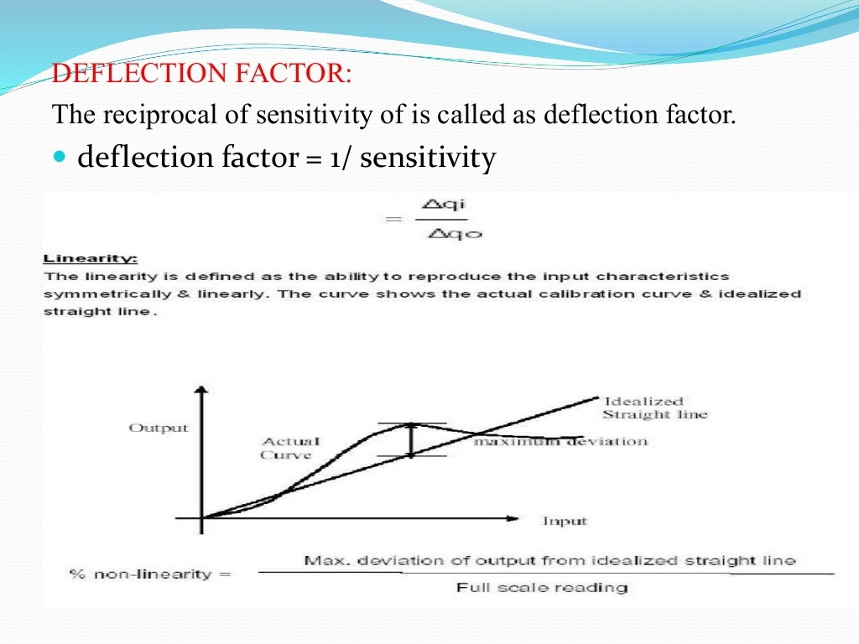

Slide 14
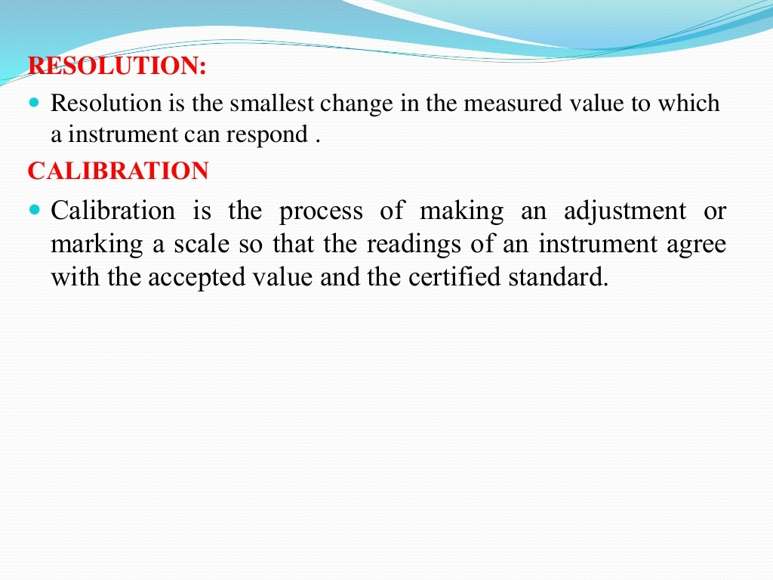

Slide 15
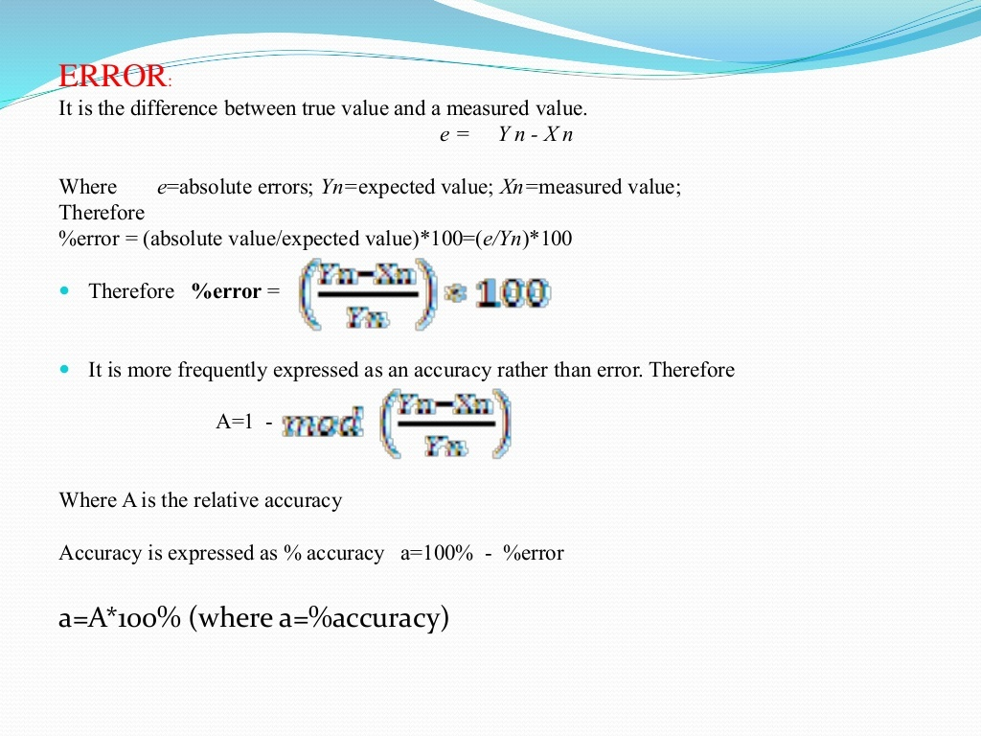

Slide 16
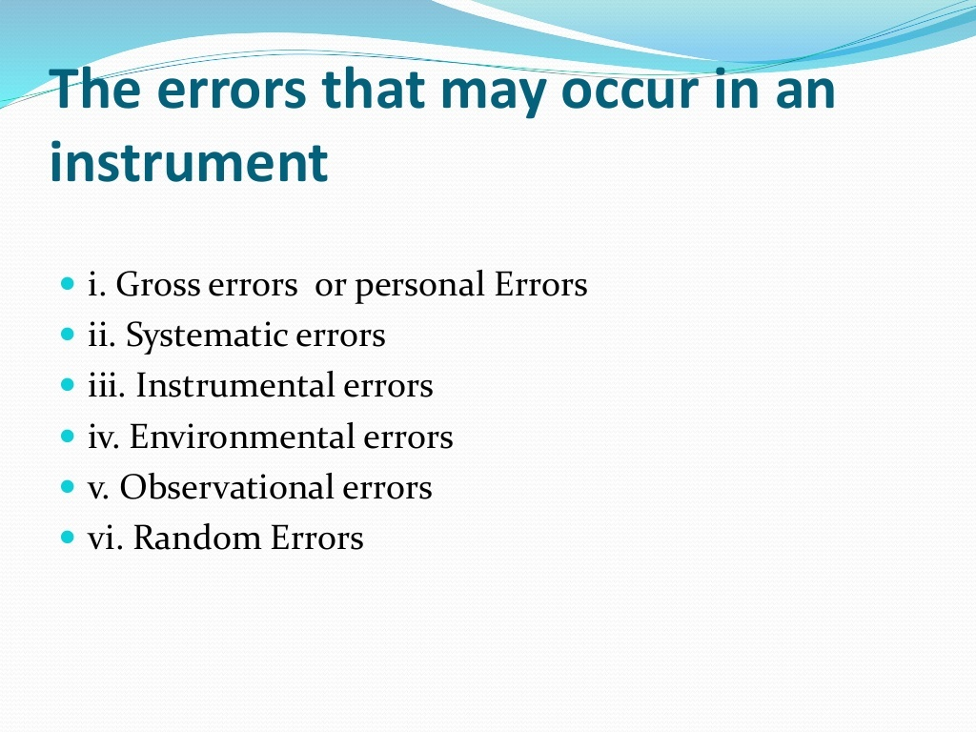

Slide 17
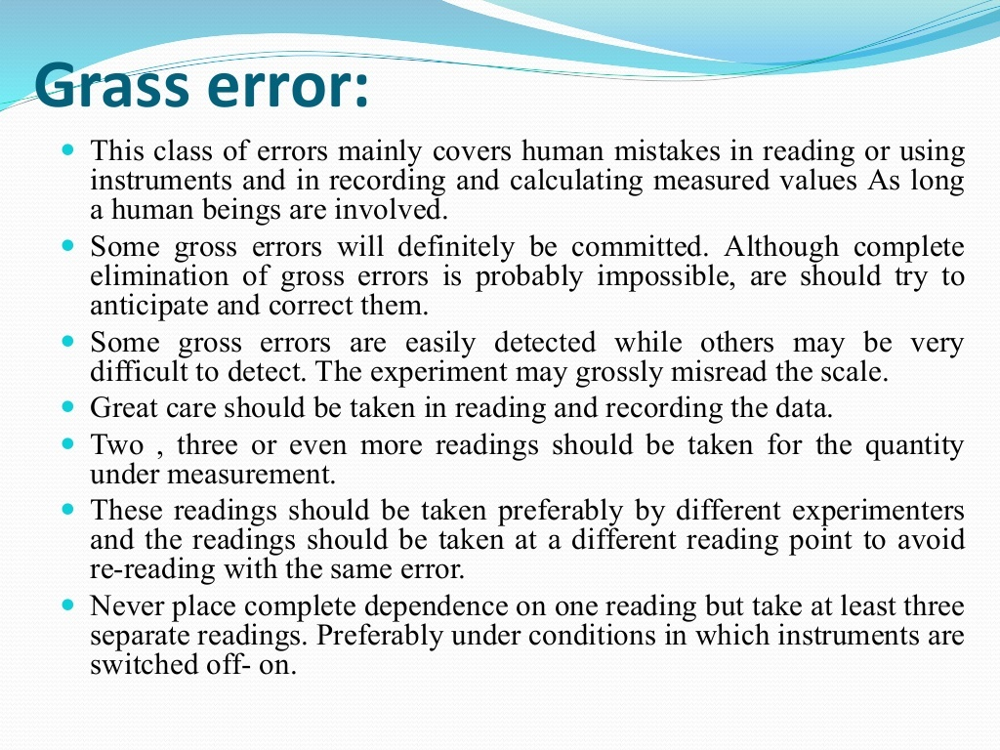
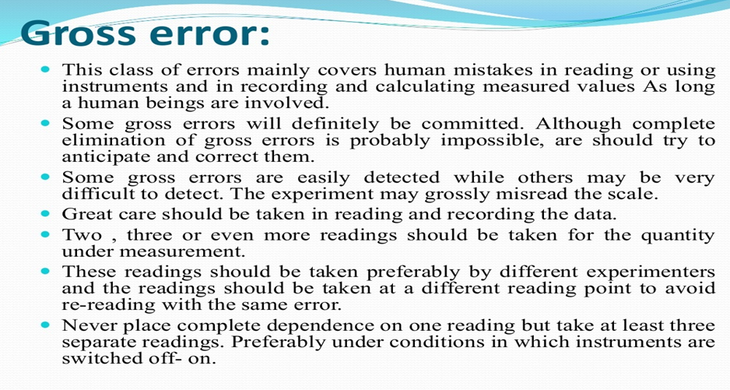

Slide 18
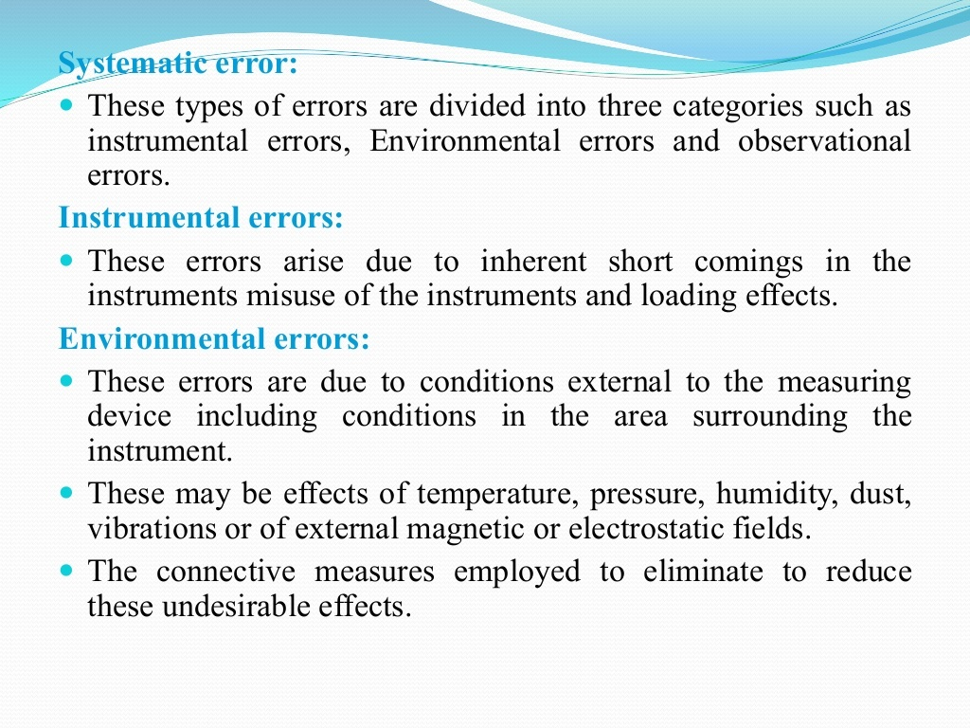

Slide 19
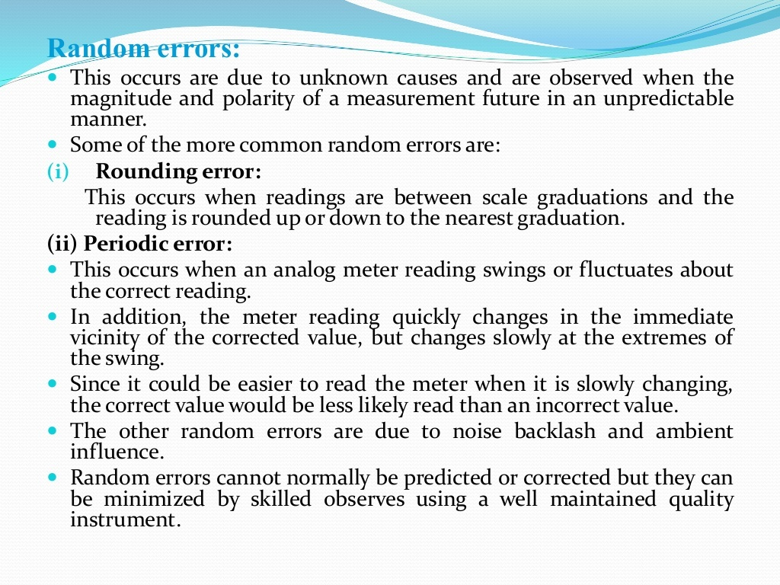

Slide 20
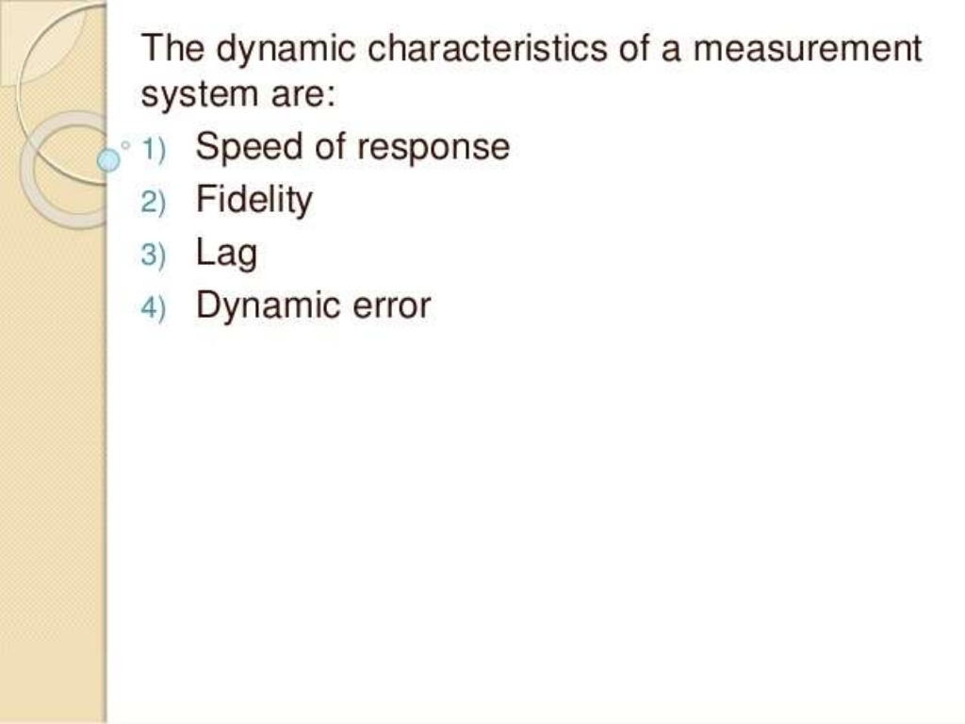

Slide 21
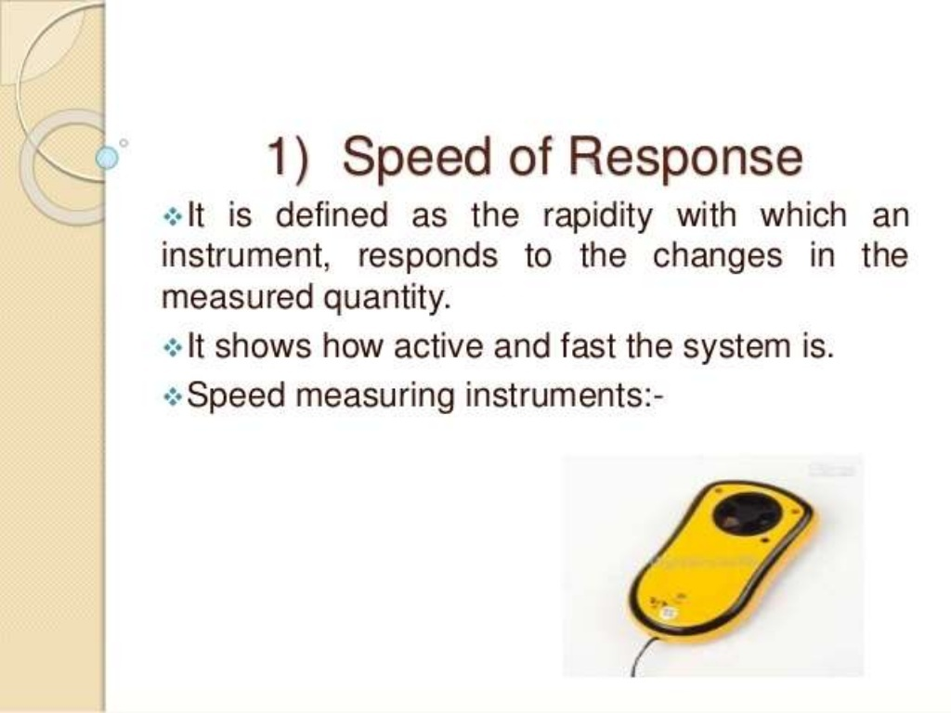

Slide 22
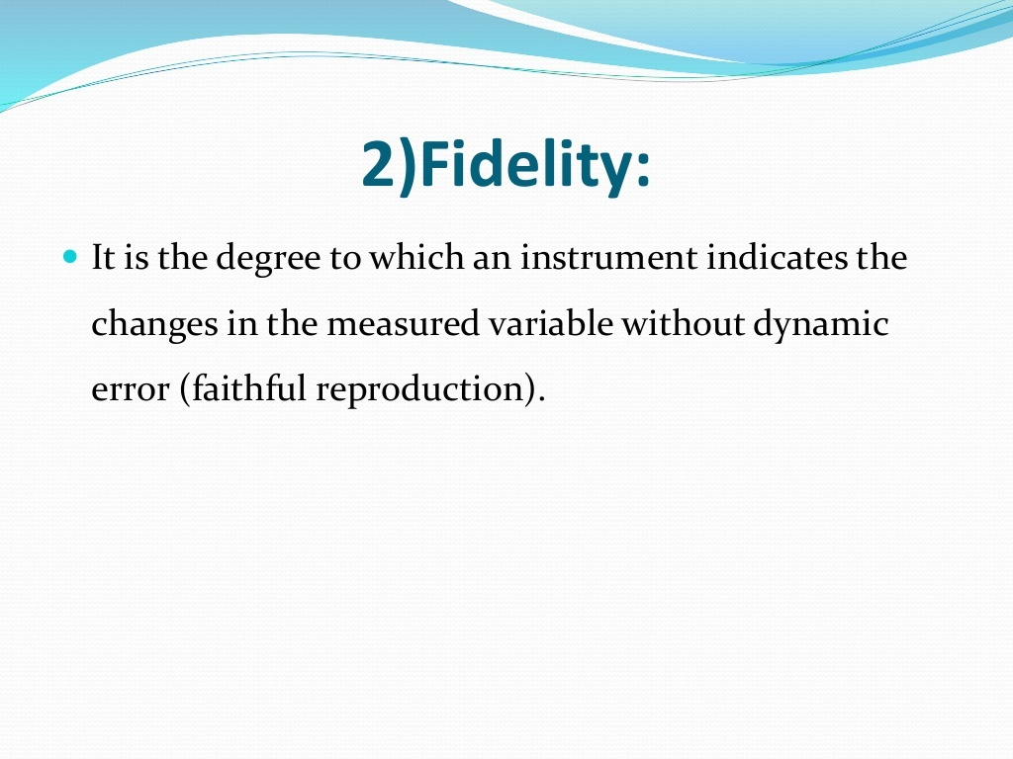

Slide 23
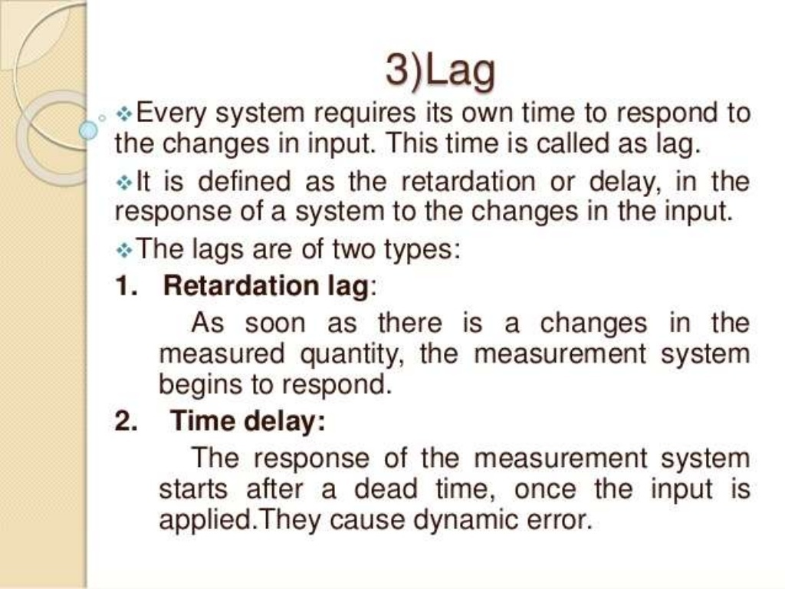

Slide 24
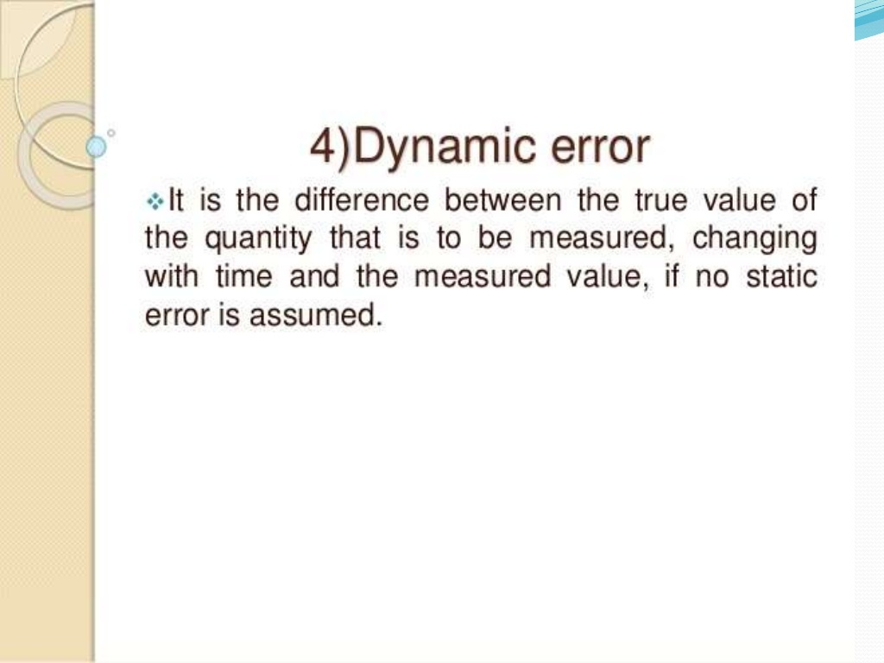

Slide 25
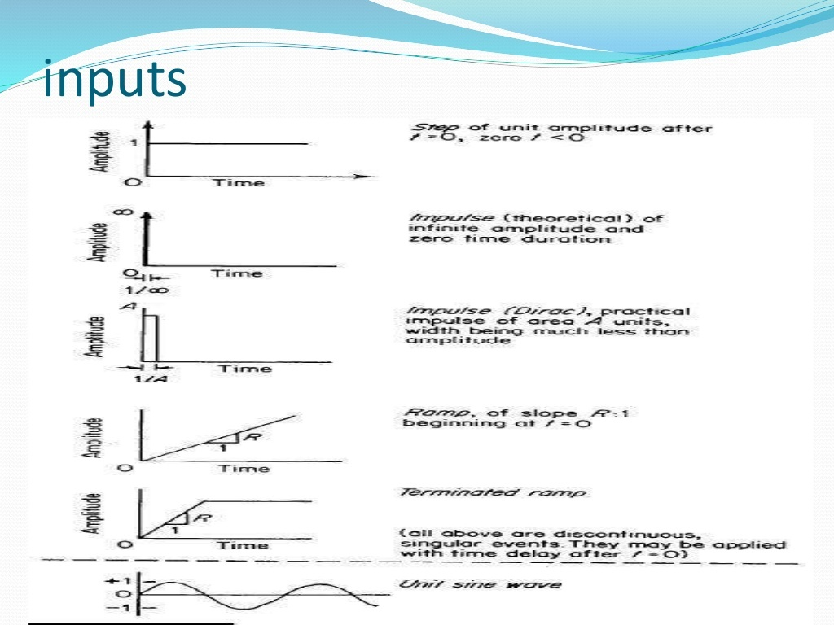

Slide 26
CLASSIFICATION OF INSTRUMENTS
Active and Passive Instruments
Monitoring and Control Type instruments
Null and Deflection type Instruments
Analog and Digital Instruments
Absolute and Secondary Instruments

Slide 27
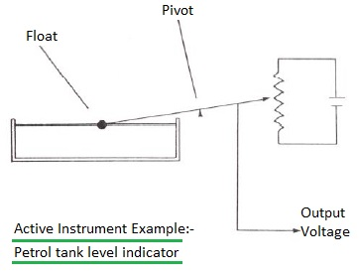
CLASSIFICATION OF INSTRUMENTS
Active instrument
The instrument type in which quantity to be measured modulates or adapts to magnitude of external power source is known as active instrument.
Example: Petrol Tank Level Indicator

Slide 28
The change in petrol level moves a potentiometer arm and the output signal consists of a proportion of the external voltage source applied across the two ends of the potentiometer. The energy in the output signal comes from the external power source. In this active instrument, primary transducer float system is merely modulating the value of the voltage from this external power source.

Slide 29
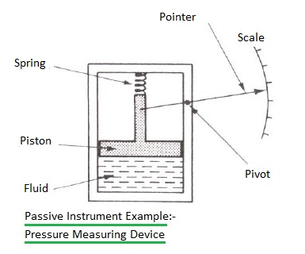
PASSIVE INSTRUMENT
The instrument type in which output entirely depends on quantity to be measured.
Example: Pressure measuring device .

Slide 30
The pressure of the fluid is translated into a movement of a pointer against scale. The energy expanded in moving the pointer is derived entirely from the change in pressure measured. In this passive instrument, there are no other energy inputs to the system

Slide 31
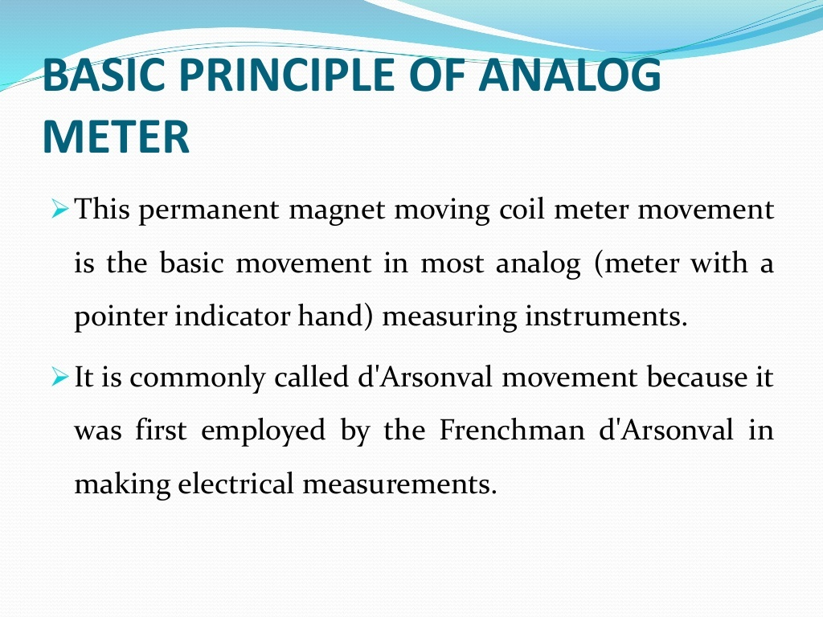

Slide 32


Slide 33
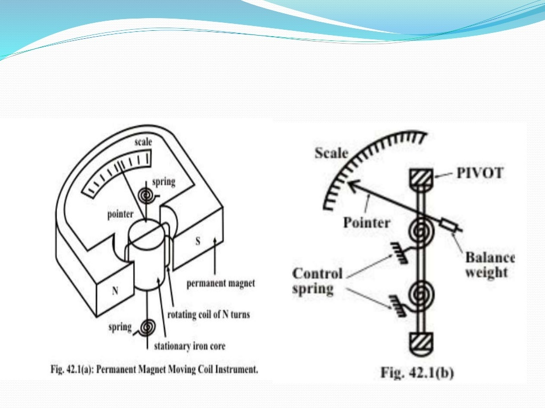

Slide 34
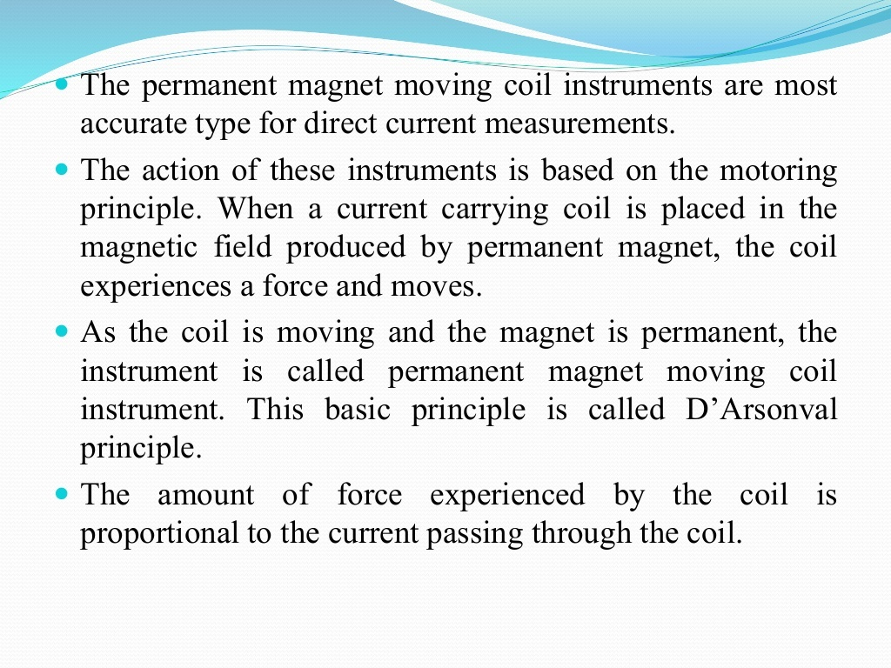

Slide 35
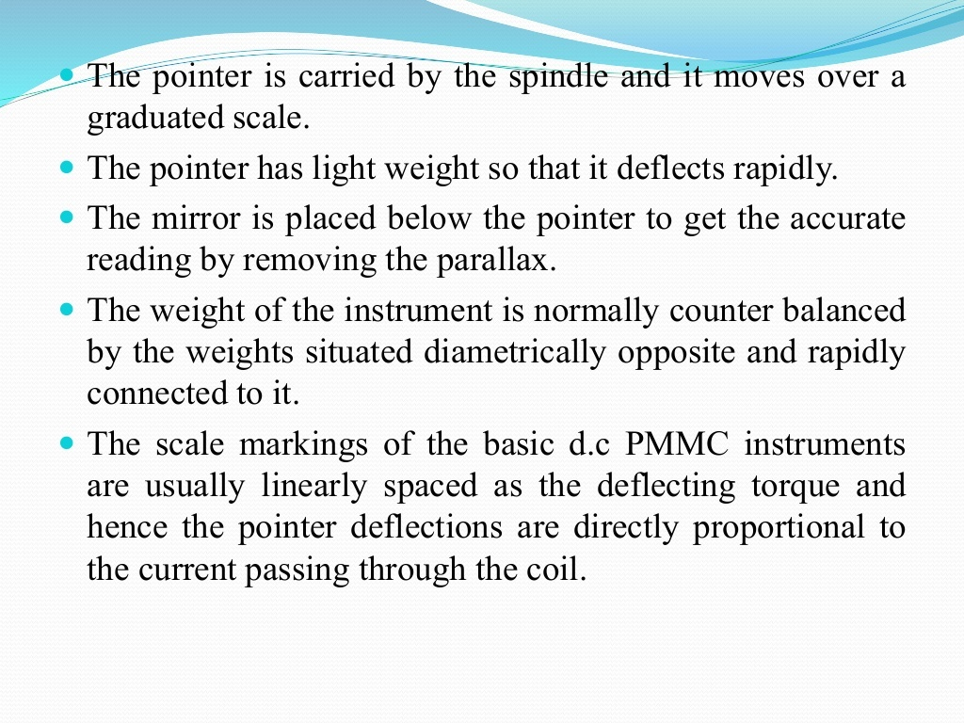

Slide 36
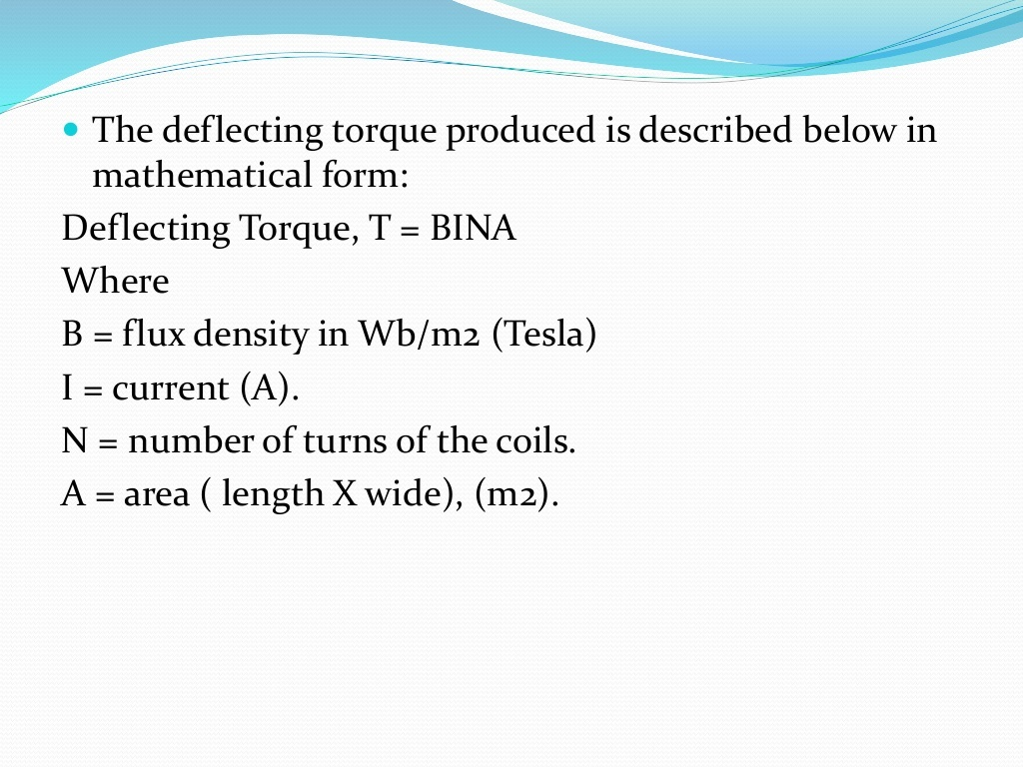
DEFLECTING TORQUE

Slide 37
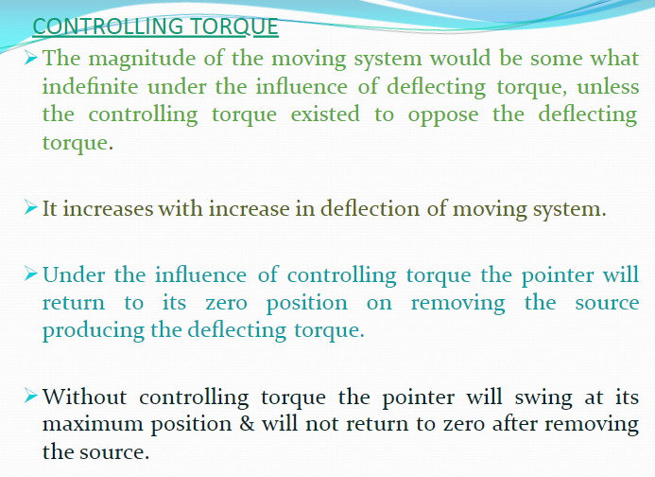

Slide 38

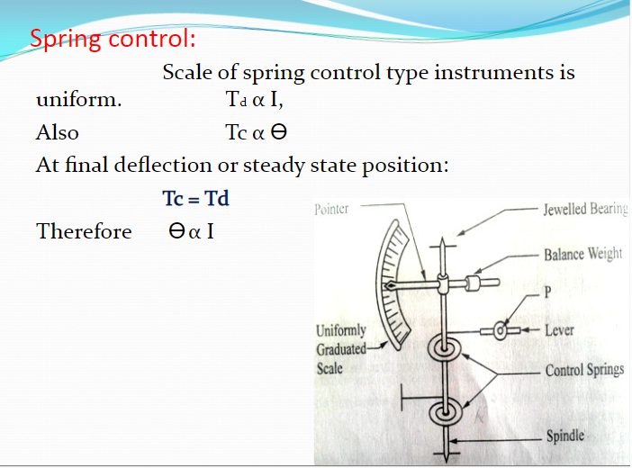
CONTROLLING TORQUE

Slide 39
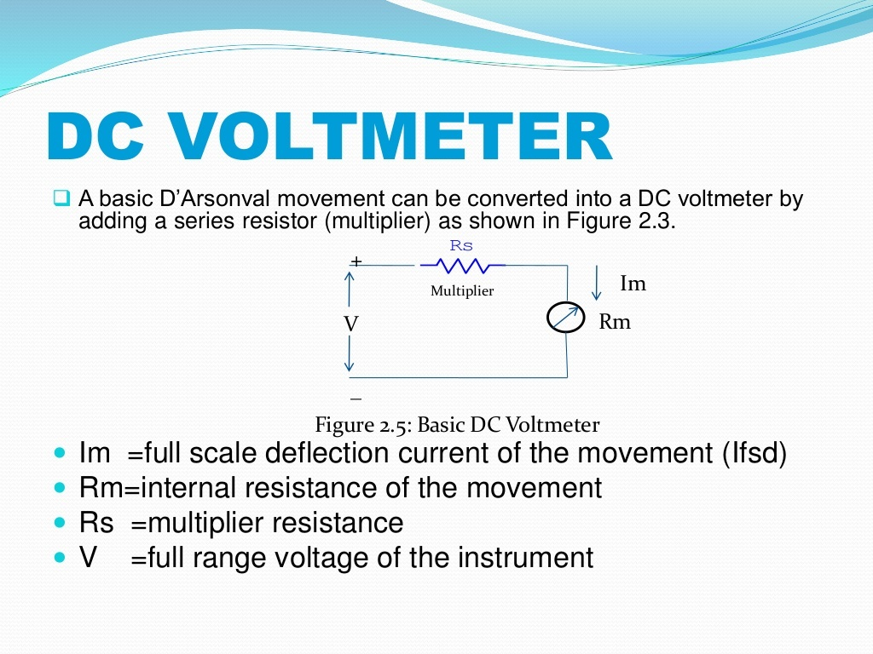

Slide 40
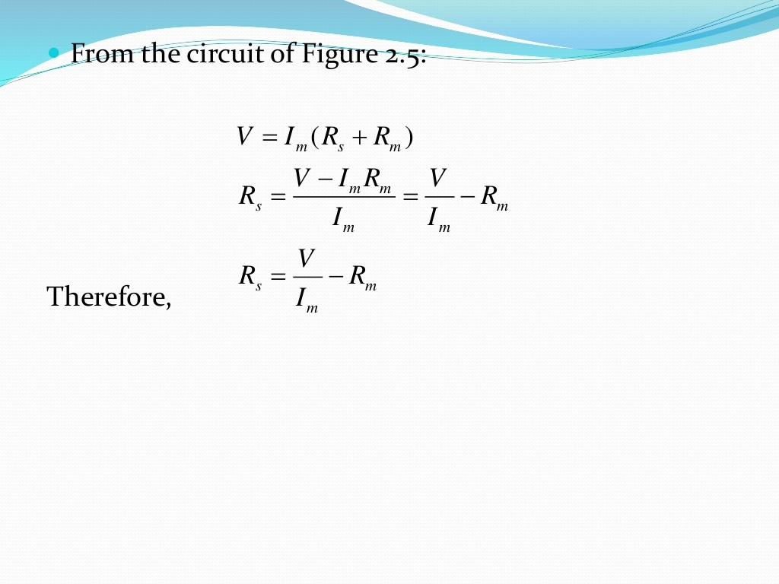

Slide 41
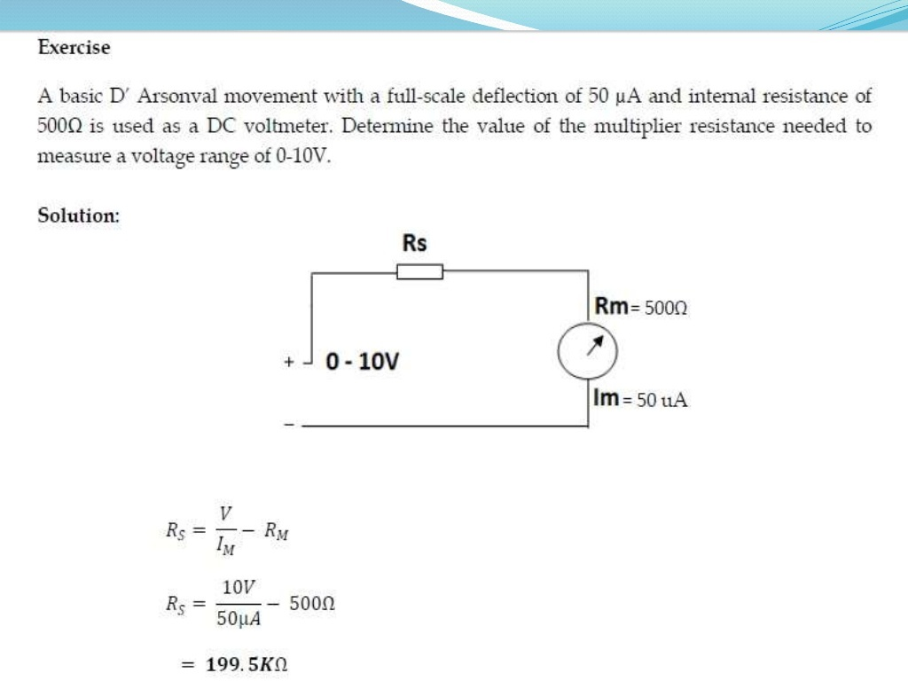

Slide 42
Multi range Voltmeter

Slide 43
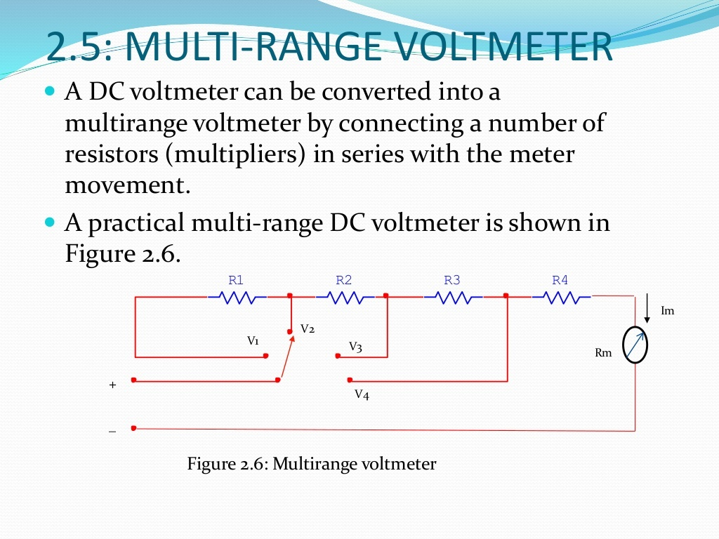

Slide 44
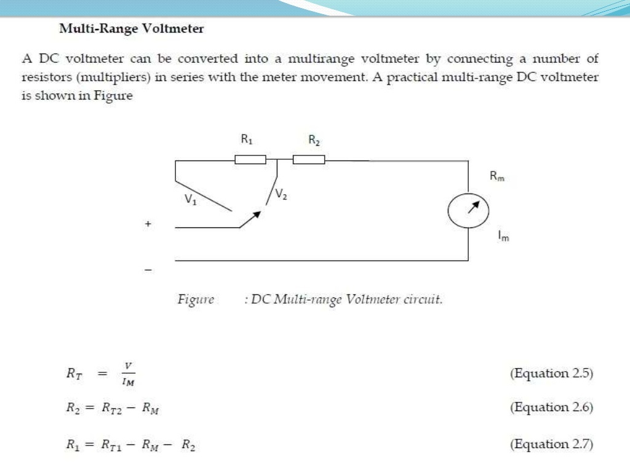

Slide 45
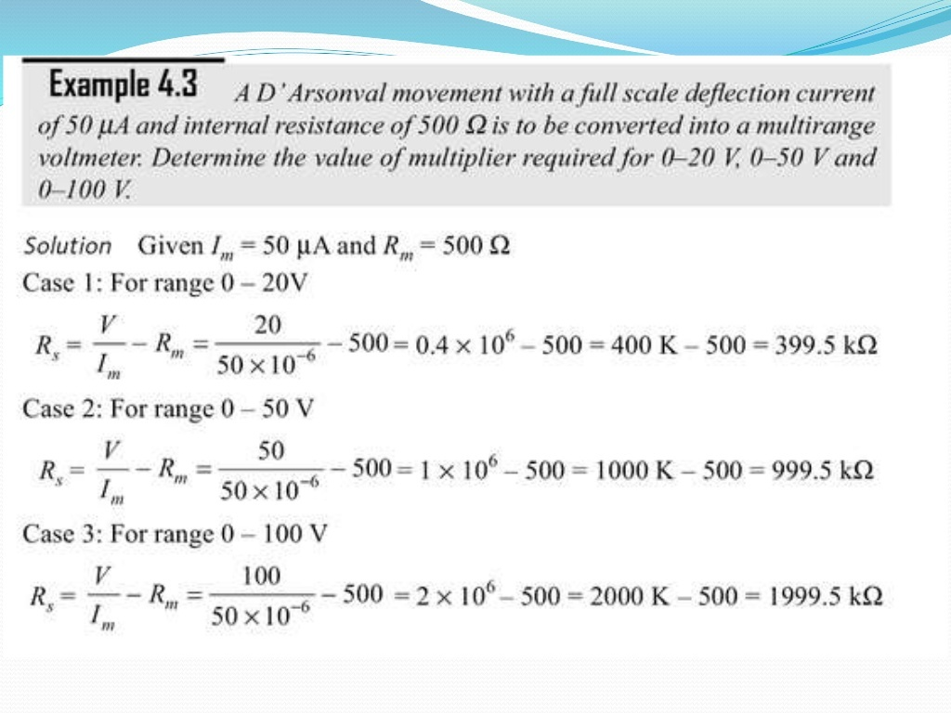

Slide 46
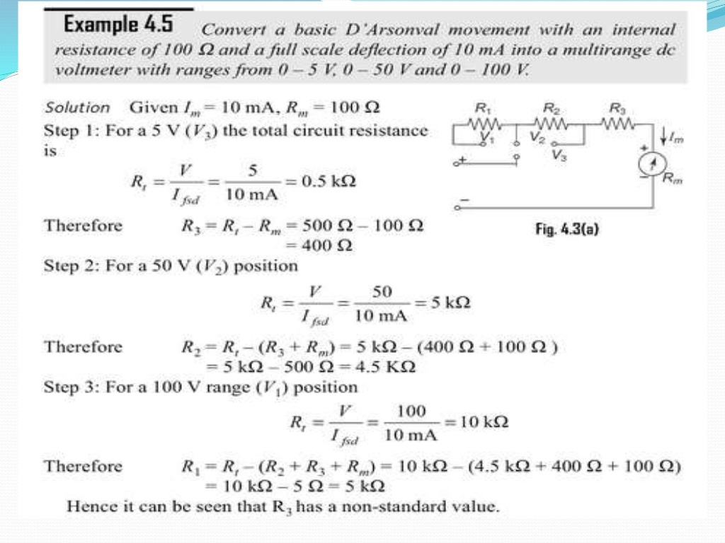

Slide 47
Sensitivity of voltmeter :
In a multirange voltmeter the ratio of the total resistance and the voltage range remains same. This ratio is nothing but reciprocal of full scale deflection current of the meter i.e. 1/I_{m}
This ratio is called sensitivity of the voltmeter.

Slide 48
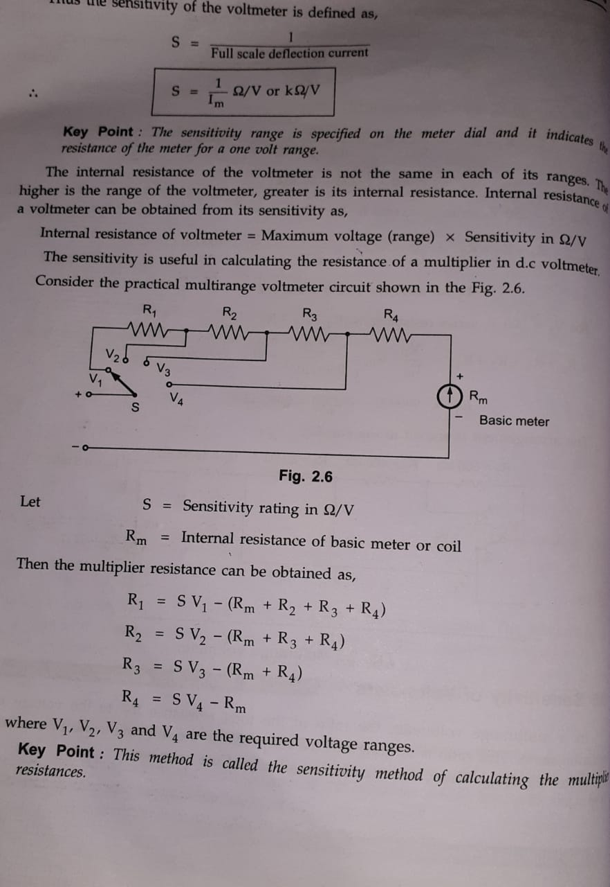

Slide 49
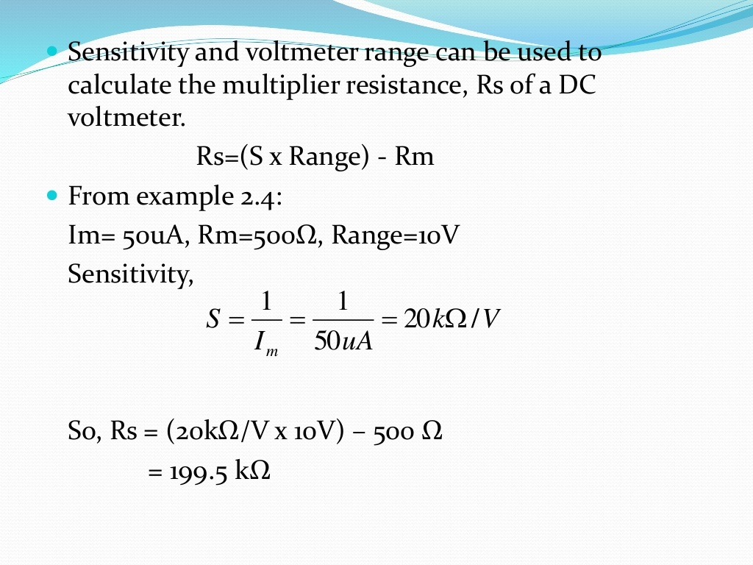

Slide 50
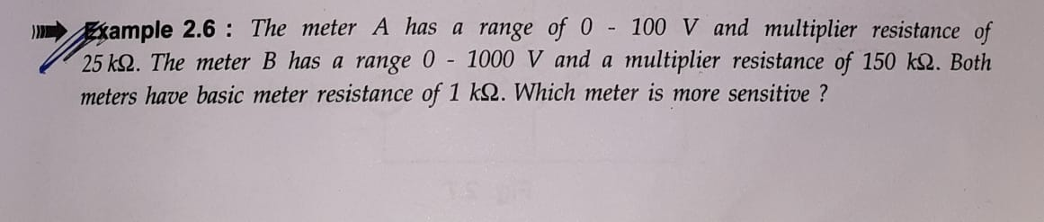
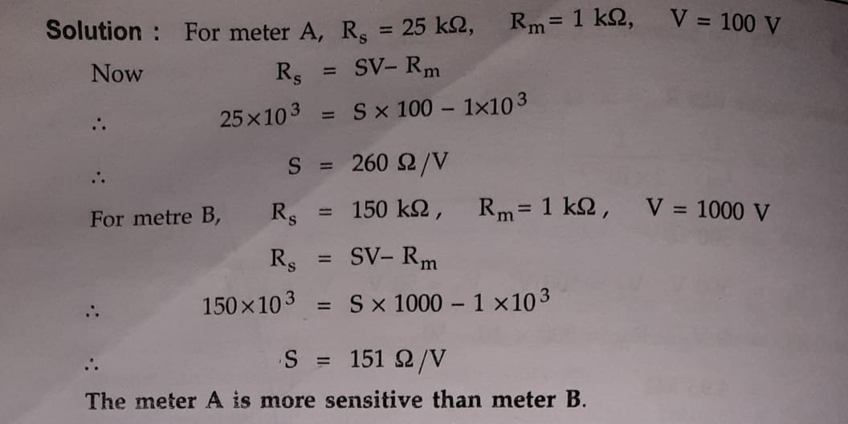

Slide 51
Loading effect:
The low sensitivity voltmeter when used in high resistance circuit gives lower reading than the true reading. This is called loading effect of the voltmeter.
Cause : Due to low sensitive voltmeters

Slide 52
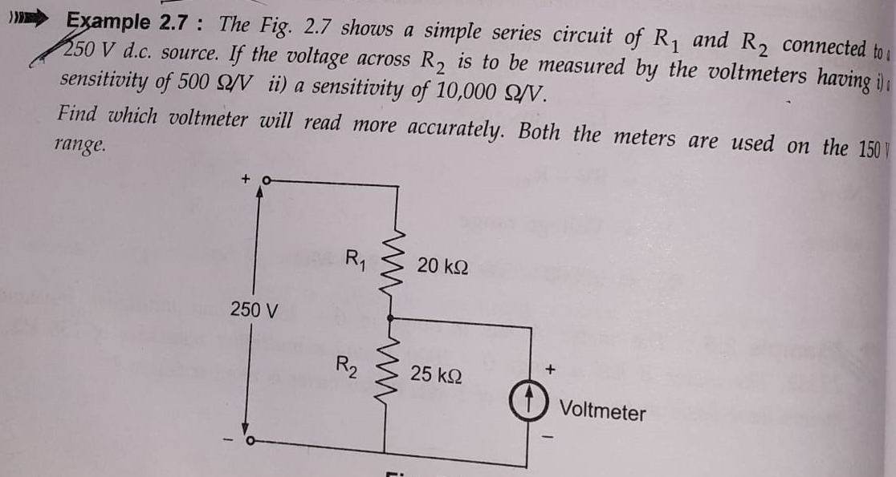

Slide 53
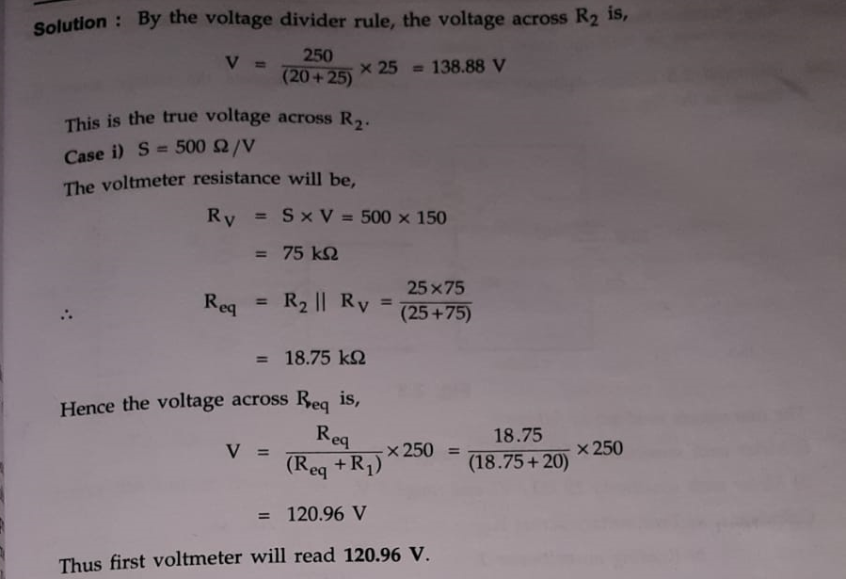

Slide 54
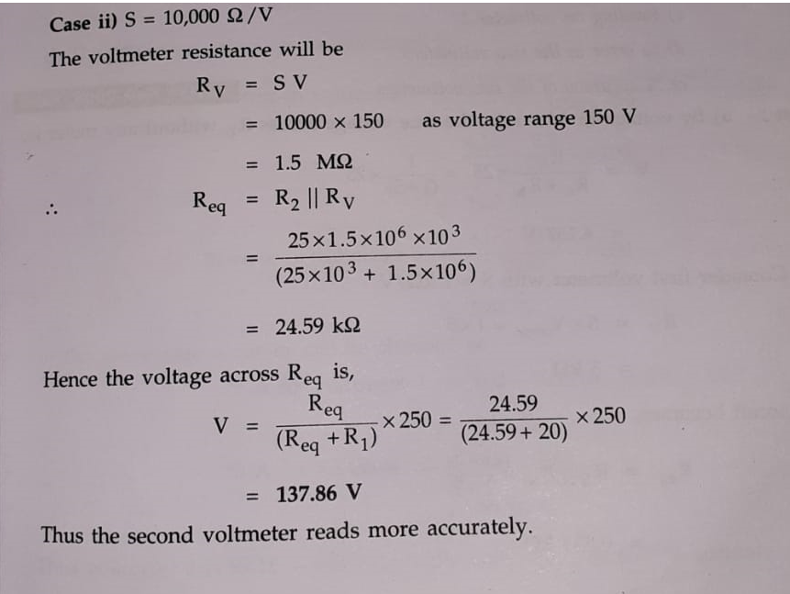

Slide 55
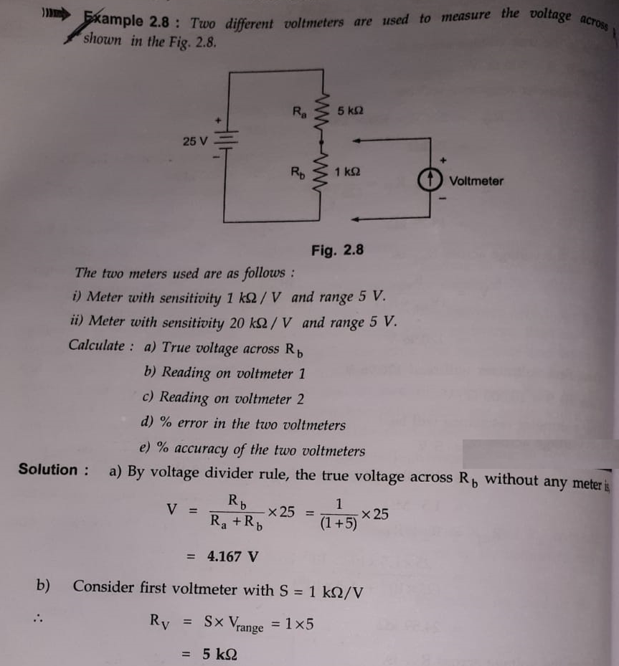

Slide 56
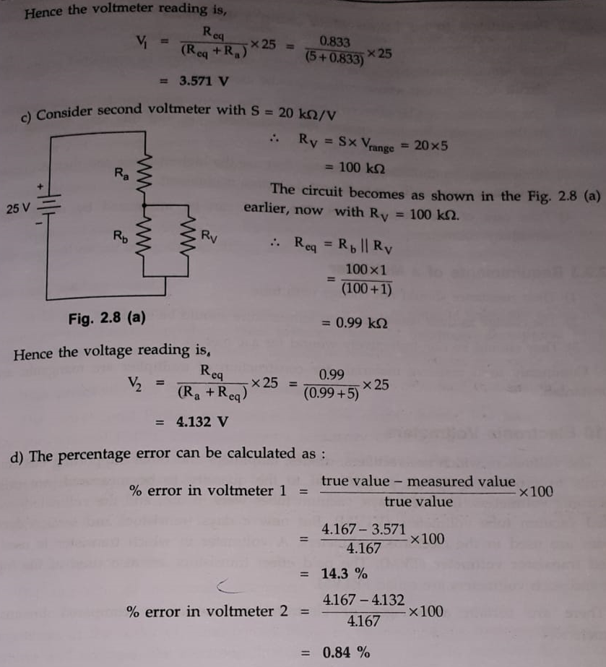

Slide 57


Slide 58


Slide 59


Slide 60


Slide 61


Slide 62


Slide 63


Slide 64


Slide 65


Slide 66


Slide 67


Slide 68


Slide 69


Slide 70


Slide 71


Slide 72


Slide 73


Slide 74


Slide 75


Slide 76


Slide 77


Slide 78


Slide 79


Slide 80


Slide 81


Slide 82


Slide 83


Slide 84


Slide 85


Slide 86


Slide 87
Operation :
Solid State Voltmeter is designed using Semiconductor Devices
( like: Op-Amp, Transistor, Diodes).
• Op-amp is a directly coupled very high gain amplifier.
The gain of the Op-Amp can be adjusted to any suitable lower value by providing appropriate resistance between its output terminal, and Negative Feedback is provided using inverting terminal of Op- Amp.
The ratio R2/R1 determines the gain of an amplifier circuit.

Slide 88
The two diodes used are for IC protection. Under normal conditions, they are non-conducting, as the maximum voltage across them is 10 mV.
If an excessive voltage, say more than 100 mV appears across them, then depending upon the polarity of the voltage, one of the diode conducts and protects the IC.
A μA scale of 50 — 1000 µA full scale deflection can be used as an indicator. R4 is adjusted to get maximum full scale deflection.

Slide 89

DIFFERENTIAL VOLTMETER
The Differential Voltmeter technique, is one of the most common and accurate methods of measuring unknown voltages. In this technique, the voltmeter is used to indicate the difference between known and unknown voltages, i.e., an unknown voltage is compared to a known voltage.
Figure 4.14 (a) shows a basic circuit of a differential voltmeter based on the potentiometric method; hence it is sometimes also called a potentiometric volt­meter.

Slide 90
In this method, the potentiometer is varied until the voltage across it equals the unknown voltage, which is indicated by the null indicator reading zero.
Under null conditions, Voltage the meter draws current from neither the reference source nor the un-known known voltage source, and hence the differential voltmeter presents an infinite impedance to the unknown source.
(The null meter serves as an indicator only.)

Slide 91


Slide 92


Slide 93


Slide 94


Slide 95


Slide 96


Slide 97


Slide 98


Slide 99


Slide 100


Slide 101


Slide 102


Slide 103


Slide 104


Slide 105


Slide 106


Slide 107


Slide 108


Slide 109


Slide 110


Slide 111


Slide 112


Slide 113


Slide 114


Slide 115


Slide 116


Slide 117


Slide 118


Slide 119


